Slide 1

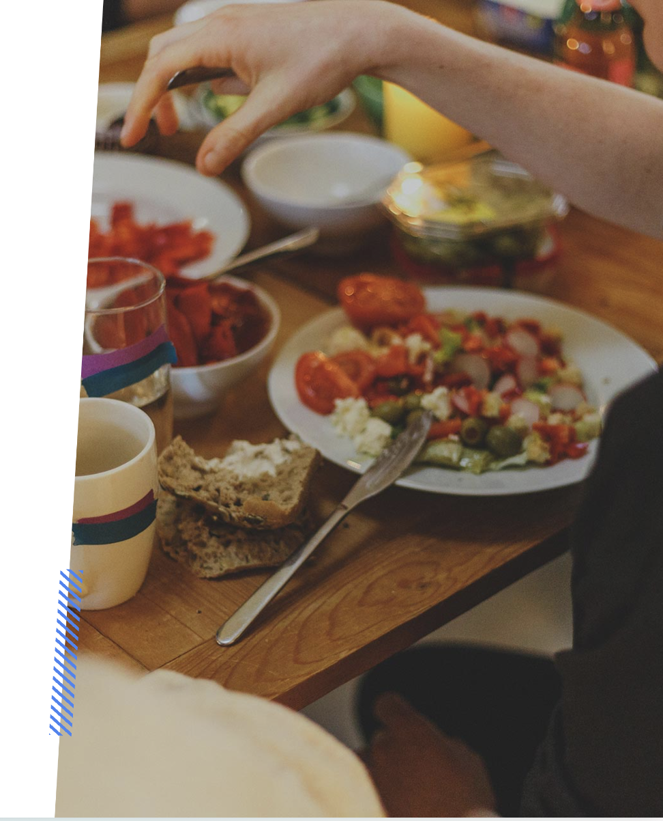
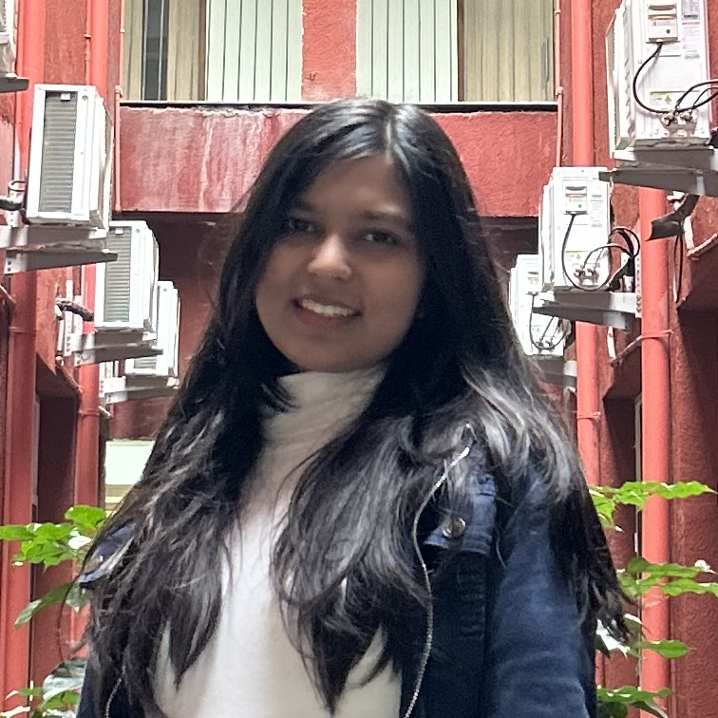


The Impact of Social Influences on College Students' Eating Habits
Understanding the influence of social factors on
college students' eating habits
Akshita Singla
Arjun Nautiyal
Prabhmehar Bedi

Slide 2





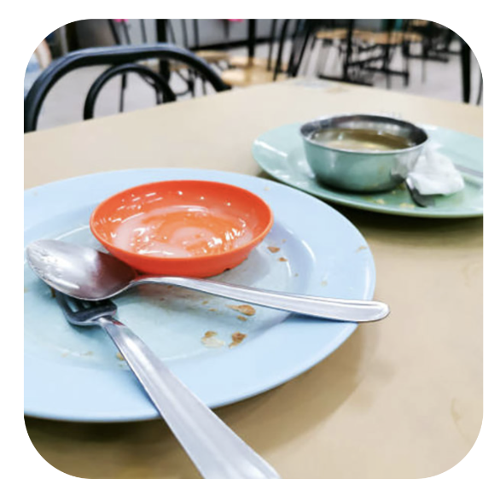
The Impact of Social Influences on College Students' Eating Habits
Dining Environment
The dining environment on campus, i.e. meal options, portion sizes, and availability, plays a crucial role in shaping students' eating habits.
Peer Pressure
College students often make food choices influenced by peers and social circles, impacting their overall eating habits.
Body Image Ideals
Exposure to social media can create unrealistic body image ideals, influencing students' eating habits and dietary behaviors.
Campus Food Culture
The usual food culture on college campuses significantly shapes students' eating habits, leading to diverse dietary patterns.

Slide 3
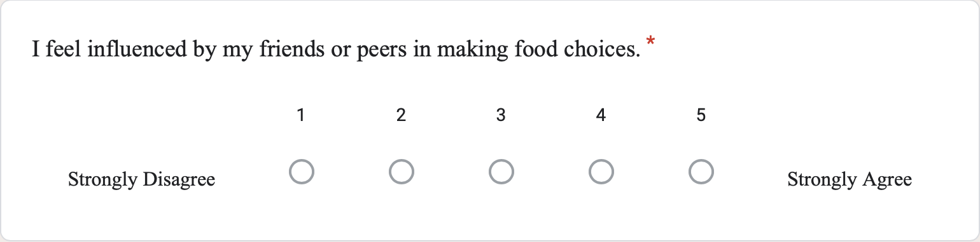

Slide 4
Pressure to fit in socially
College life is often associated with socializing, hanging out, and partying.
Pressure to fulfill social commitments that interfere with eating schedule
Students may feel compelled to eat unhealthy foods to fit in or participate in social events.
Constant exposure to unhealthy eating habits among peers can normalize poor dietary choices.
Students may consume high-calorie snacks or greasy foods while drinking, contributing to weight gain and poor nutrition

Slide 5
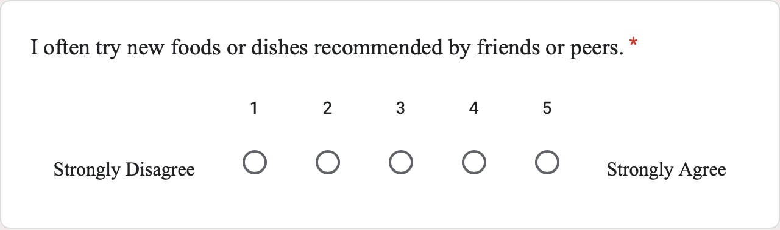

Slide 6




Social Influence Factors on College Students' Eating Habits
Understanding the Impact of Peer Pressure, Social Media, Friendships, and Cultural Traditions
Peer Pressure
Peer influence significantly impacts food choices and eating behaviors among college students.
Social Media
Social media plays a pivotal role in shaping college students' attitudes towards food and dining habits.
Dining with Friends
Eating with friends leads to the adoption of similar eating preferences, influencing one’s food choices.
Cultural and Family Traditions
Family practices also influence dietary preferences and habits, shaping students' eating behaviors.

Slide 7
Peer Pressure Influence on College Students' Eating Habits
Examining the impact of peer pressure on food choices and eating behaviors among college students
*College Health and Nutrition Survey, 2021

Slide 8
The Impact of Social Influences on College Students' Eating Habits
Examining the impact of dining with friends on food choices
Frequency of Dining with Friends | Types of Food Choices | Influence on Portion Sizes and Meal Timings
Several Times a Week | Healthy and Unhealthy Options | Increased Portion Size and Altered Meal Timings
Once a Week | Mainly Unhealthy Options | No Significant Influence on Portion Sizes and Meal Timings
Rarely | Healthy Options | No Significant Influence on Portion Sizes and Meal Timings

Slide 9
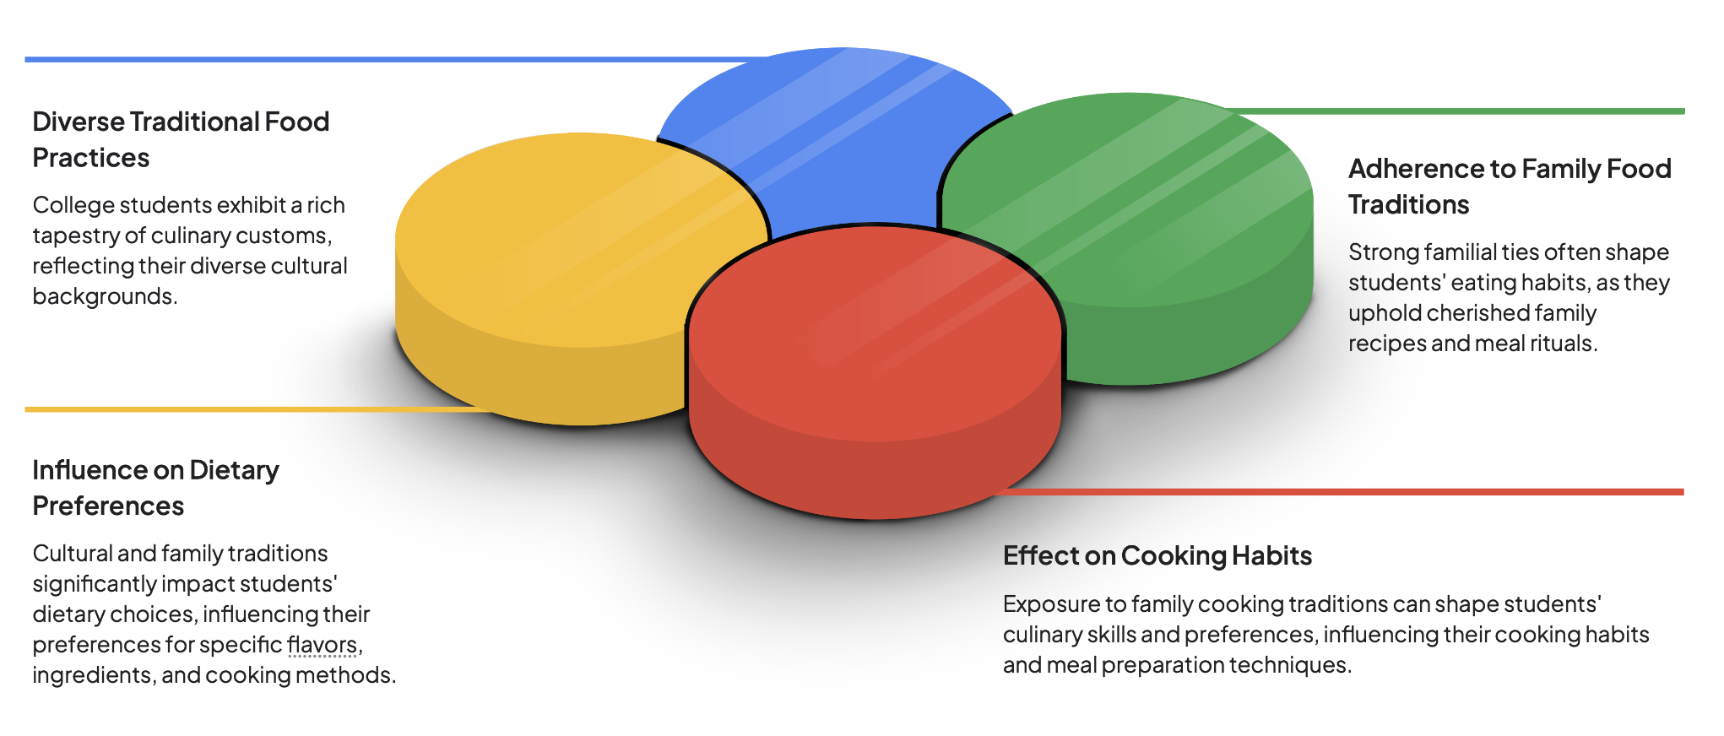
The Influence of Cultural and Family Traditions on College Students' Eating Habits
Examining the Impact of Traditional Food Practices and Family Influences

Slide 10




Strategies for Promoting Healthy Eating Habits
Effective approaches to encourage healthy eating amidst social influences
Educational Campaigns
Implement informative campaigns to raise awareness about healthy eating choices and their impact.
Peer Support Programs
Establish support systems among college students to encourage and reinforce healthy eating practices.
Promotion of Healthy Social Dining Options
Encourage the availability and promotion of nutritious dining options in social settings on campus.
Cultural Sensitivity in promoting Healthy Eating
Recognize and respect cultural influences on dietary preferences while promoting healthy eating habits.

Slide 11
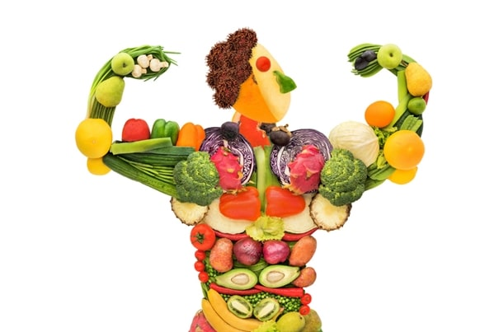
Steps to be taken by hostels to improve eating habits
Menu variety
Including fruits along with cooked dishes
Customization
Nutritional Information-calorie count, sodium level, allergens
Cultural Sensitivity

Slide 12

Take Charge of Your Eating Habits
Empower yourself to make positive choices and influence others around you for a healthier college community

Slide 13
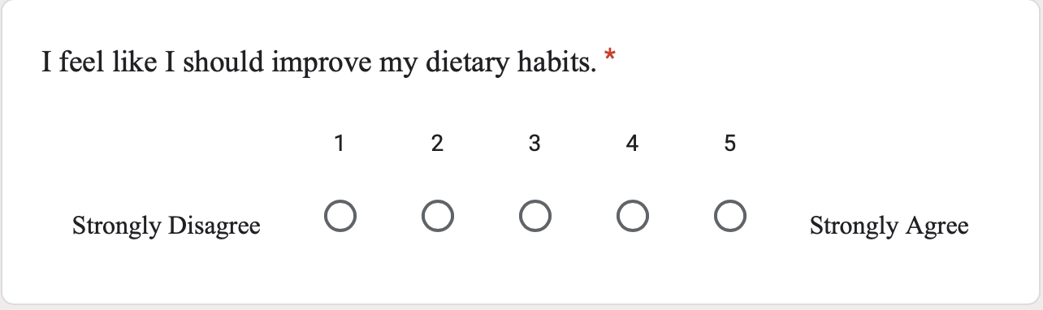

Slide 14
References
https://boynton.umn.edu/sites/boynton.umn.edu/files/2022-08/umntwincities_cshsreport_2021.pdf
https://www.researchgate.net/publication/356770744_Eating_habits_in_university_students_of_health_science_programs
https://forms.gle/9PmAVE7Wm27XoKsEA

Slide 15

Thank You
Feel free to share your valuable feedback !

